Slide 1
AIML CA1
Regression
Name: Lim Yu Yang Ian
Admin No: 2201874
Class: DAAA/FT/2A/02

Slide 2
Objectives and background
Objective
Background
Information
To predict the price of a house using the given attributes.
A house has many factors that lead to determine. It’s location, surrounding amenities, size, number of different rooms, and many other factors.
For the real estate market, a buyer must value a property higher than the amount they are willing to trade for the property. At the same time, the seller must value the property at a price below the money offered.

Slide 3
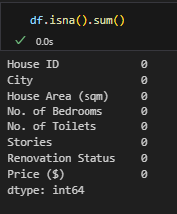
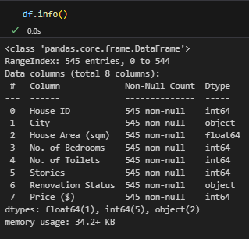
Data Observations
There are no Null values in this dataset, thus there is no need do handling of Null values.
As shown on the right.
There are 545 data entries
Our target attribute here is Price ($)
The dataset provided has very few values

Slide 4
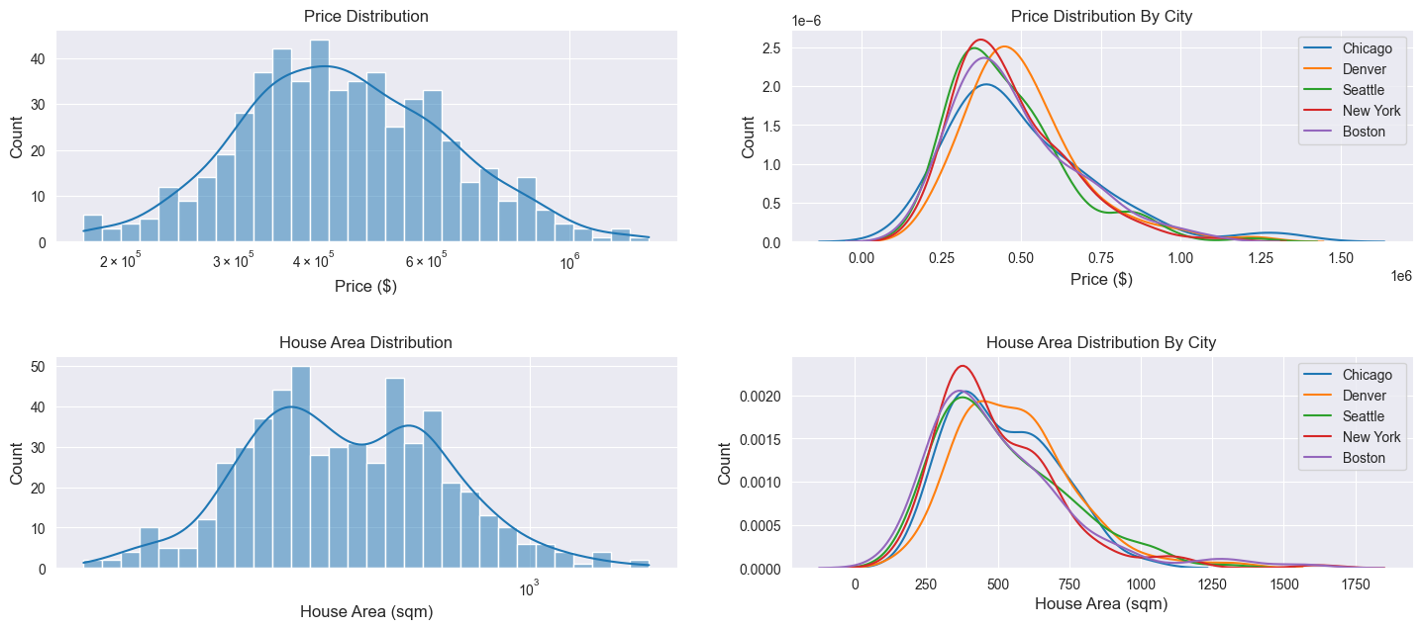
Data Observations
We can see the distribution of price and area per square meter. We can also see them sorted by city.
Price, our target variable is very skewed to the left.
Thus I will need to use a log function to resolve this issue.

Slide 5
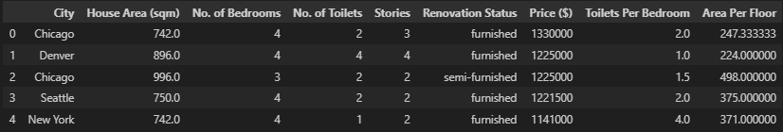
Feature Engineering
Added:
Toilets per bedroom: Ratio of toilets to bedrooms
Area per floor: Average area on each floor
Dropped:
House ID: No correlation

Slide 6
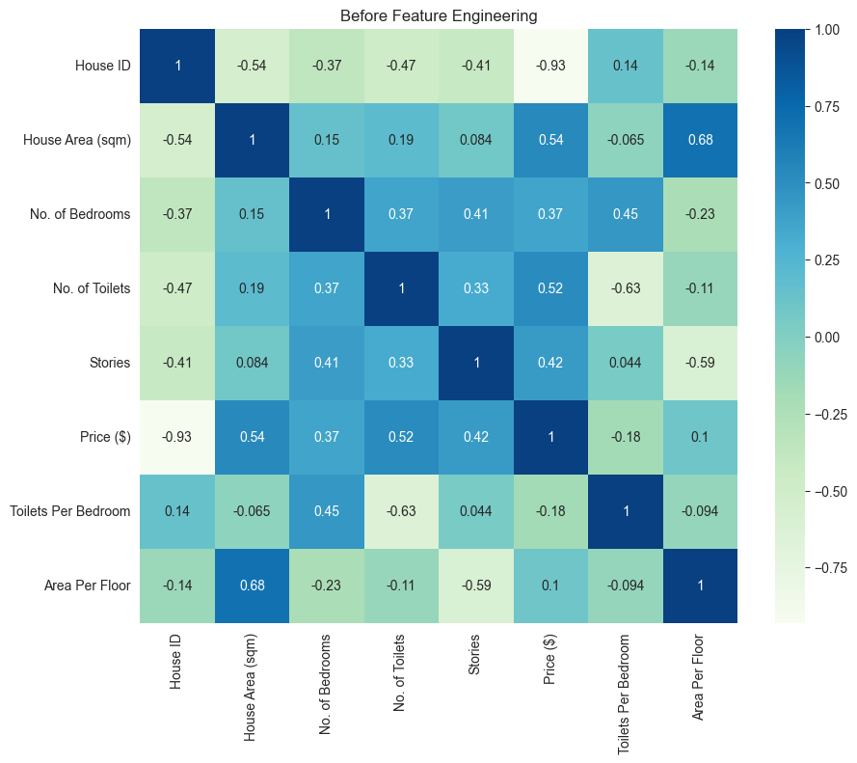
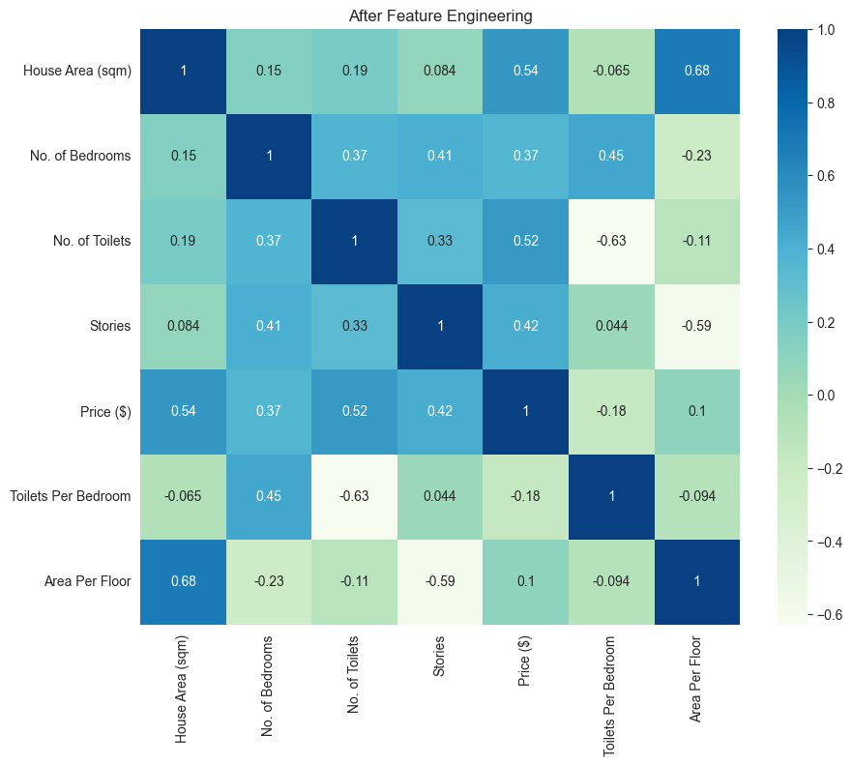
Correlation
Before
After

Slide 7

Encoding
I use One Hot Encoding (OHE) to encode my categorical data.
My categorical data does not have a large number of categories, and thus makes OHE appropriate to use.
I also split my data into 70% for training, and 30% for testing

Slide 8
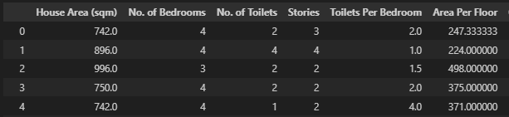
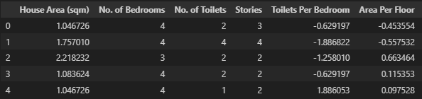
Standard Scaling
I use standard scaling to make it easier for my model to work.
Above is the output of my train data after being Standardized

Slide 9
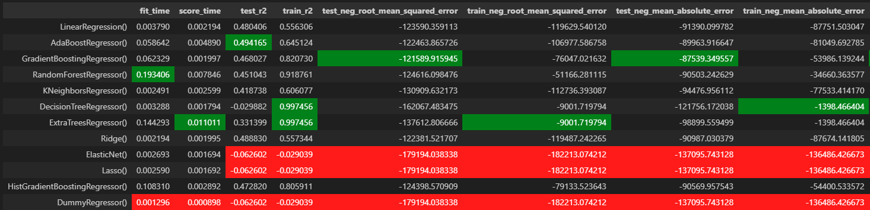
Model Selection
After running all my models, using the cross_validate function, I get the values below.
I will be using r^2 as my scoring metric.
Based on r^2 value alone, Ridge, Linear Regression, AdaBoost Regression, Gradient Boosting Regression, and Hist Gradient Boosting have the highest scores.

Slide 10
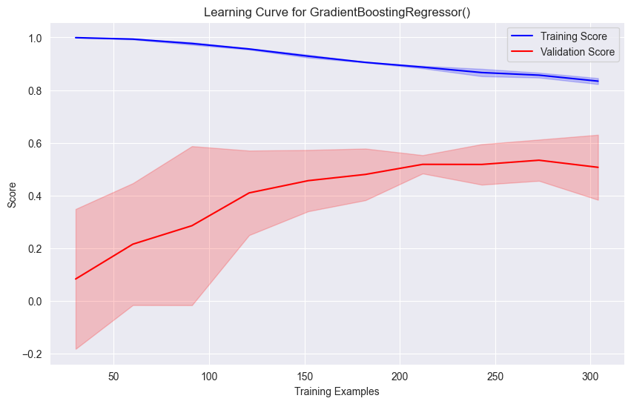
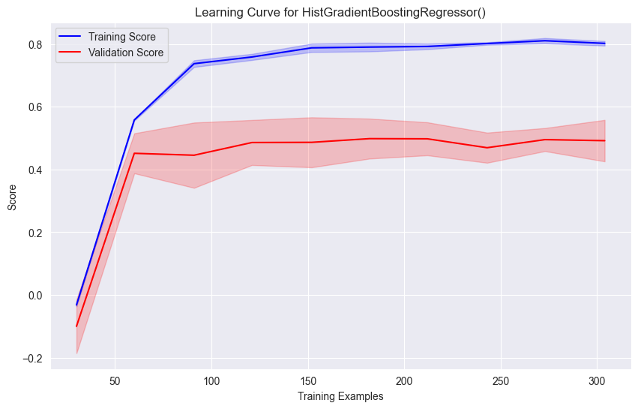
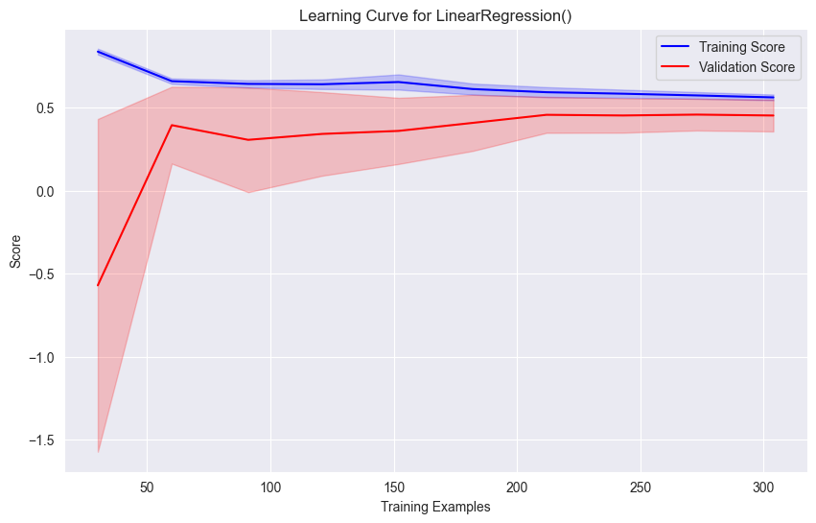
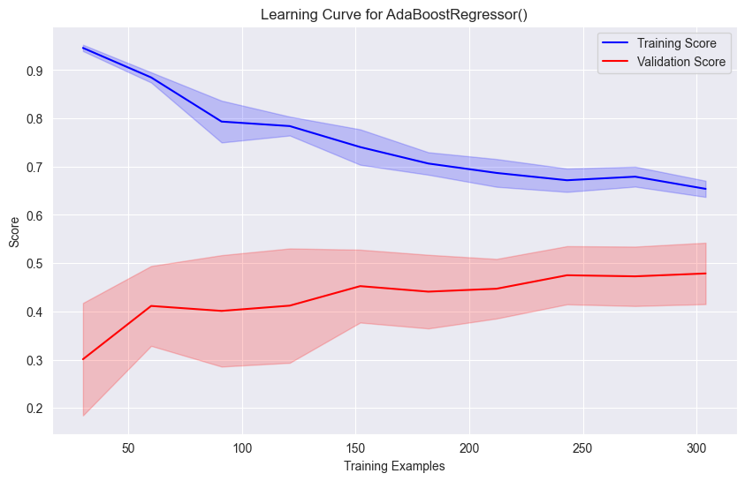
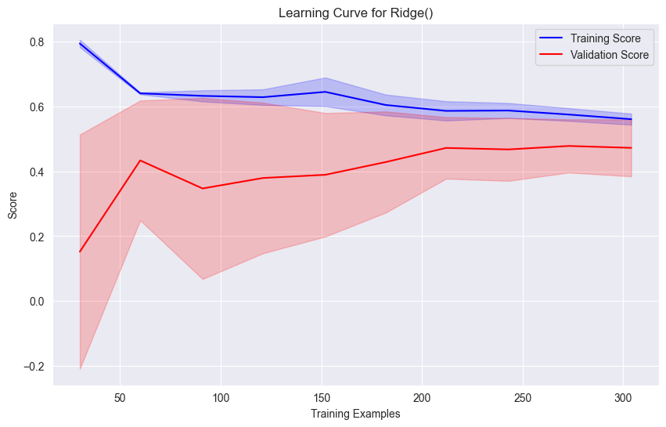
Learning
Curves
Hist Gradient Boosting:
Validation score stagnates after about 75. Training score increases a lot. Good learning curve.
Gradient Boosting:
Validation score increases quite a bit. Good learning curve.
Linear Regression:
Validation Score stagnates after about 60. And does not increase by much.
Eliminated.
Ada Boost:
Validation score increases with training examples consistently. Good learning curve.
Ridge:
Validation score stagnates after about 75. Does not increase by much.
Eliminated.

Slide 11
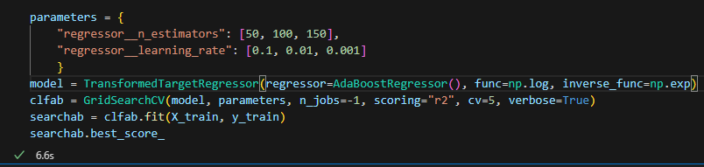
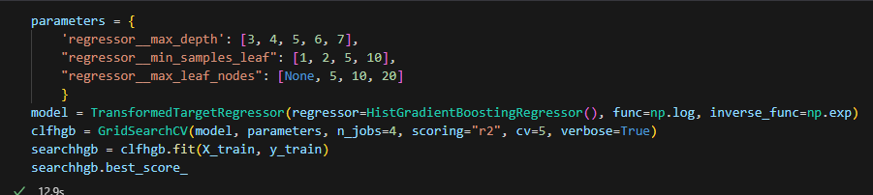
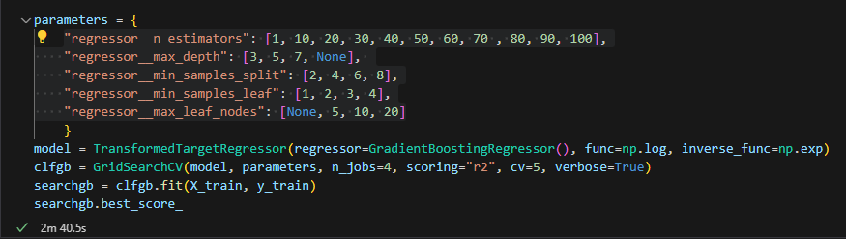
Hyper Tuning
I Use the following parameters:
AdaBoostRegressor:
n_estimators
learning_rate
HistGradientBoostingRegressor:
max_depth
min_samples_leaf
max_leaf_nodes
GradientBoostingRegressor:
n_estimators
max_depth
min_samples_split
min_samples_leaf
max_leaf_nodes

Slide 12
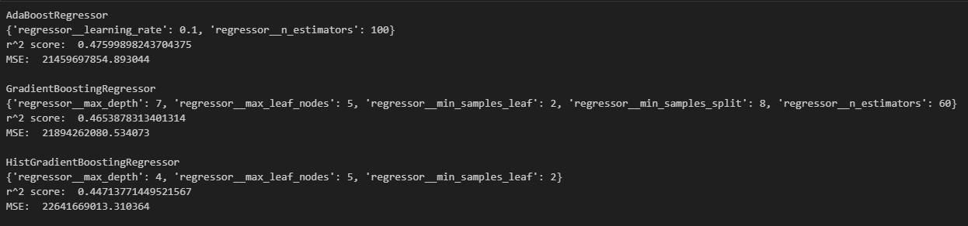
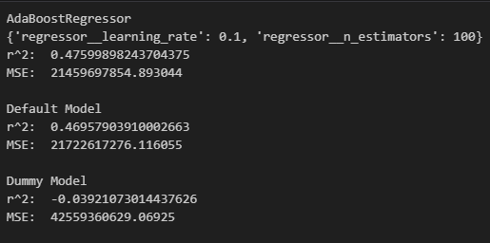
Final Model
From the top image, we can see AdaBoostRegressor, when tested against test data, provides the highest r^2 score.
From the image on the left, we can see
that the tuned model provides a better r^2 value over the default AdaBoostRegressor and the dummy model

Slide 13
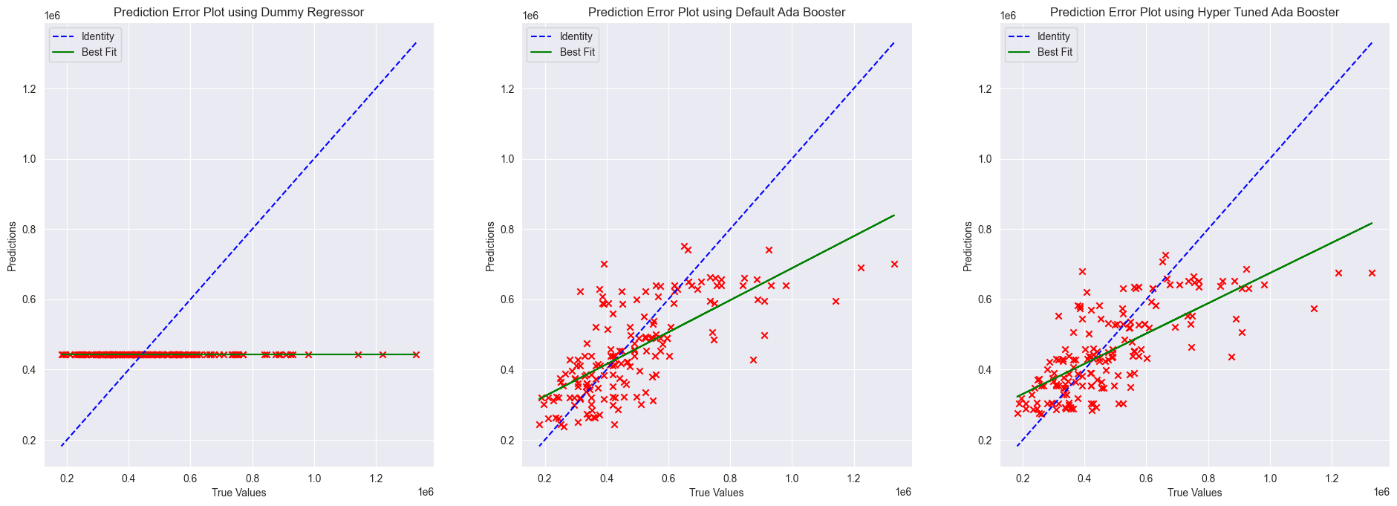
Error plotting
The above graph is the errors plotted. We can see that the hyper tuned model has the closest best fit line to the identity line. And thus is the closest to following the trend of prices.
The dummy model does not follow the trend at all.

Slide 14
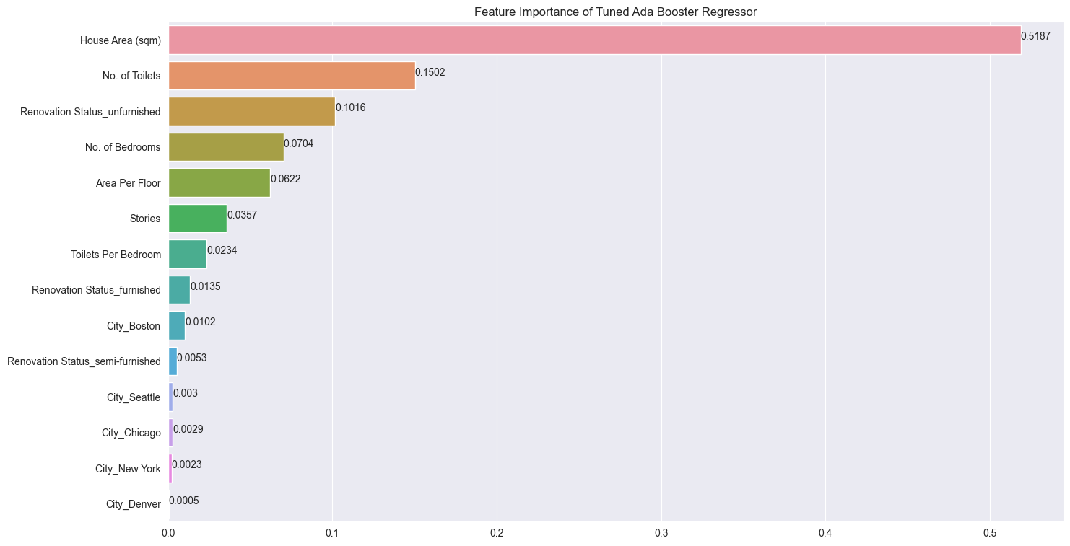
Feature Importance
We can see from the graph that the House Area, and No. of toilets were the most important features.
Engineered Features:
Good:
Area per floor (5%)
Bad:
Toilets per bathroom (2%)

Slide 15
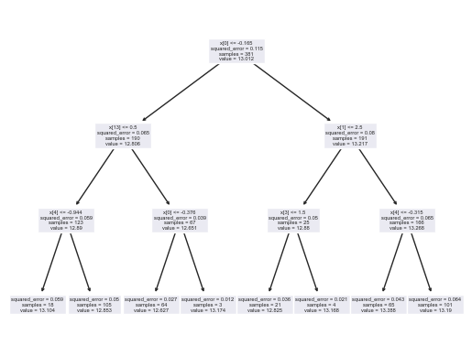
Summary
We have successfully created a model that is able to predict the price of houses.
Using the hyper tuned Ada Boosting Regressor model, I have obtained an r^2 value of 0.475, and a Mean Squared Error of 21459697854.
This means that my model can explain about 47.5% of the variance in my data.
My model is also a huge improvement from a dummy model, and the default ada boosting regressor model.
As shown in the error plot, there is still room to improve the model. However, in order for the model to be fully deployed, I believe that more data is needed in order to allow the model to train and test on more quality data.

